Slide 1
Chapter 24 Revolutions of 1848
“Do you not feel -- what shall I say? -- as it were a gale of revolution in the air?...”
- Alexis de Tocqueville, January 29, 1848 (“The French Revolution of 1848”).
By: Lynn Wang
Period 5
<http://platypus1917.org/wp-content/uploads/2010/05/Jerzy-maerz1848_berlin.jpg

Slide 2
The Causes
Events preceding Revolutions of 1848:
Industrialization (better communication, higher literacy)¹
Romanticism (nationalistic sentiment) ¹
Two years of bad harvests, industrial recession ¹
Dissatisfaction with the government + anger over climbing food prices and unemployment + liberalism and nationalism ¹ …
Revolutions of 1848
¹ (Chambers)

Slide 3
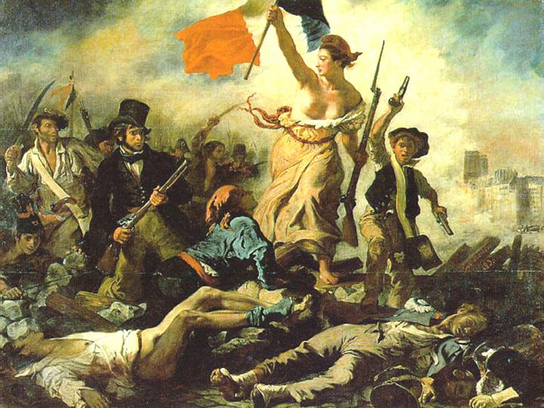
What is Nationalism and Liberalism?
Nationalism:
“A shared sense of regional and cultural identity” ^{(Chambers 713)}
Shown especially in custom, language, religion ¹
Improved communication, social mobility, greater literacy → a sense of community ¹
Desire for independence ¹
Change = progress ¹
Liberalism:
Based off of ideas of liberty,
equality ²
John Locke’s ideas ²
Man is fundamentally good,
rational ³
Generally supports:
Civil rights ²
Freedom of the press ²
More participation of the people in government ²
“Liberty Leading the People” - Delacroix
<http://www.globalresearch.ca/articlePictures/French%20Revolution.jpg>
¹ (Chambers)
² (“Liberalism” - wiki)
³ (“Liberalism”)

Slide 4
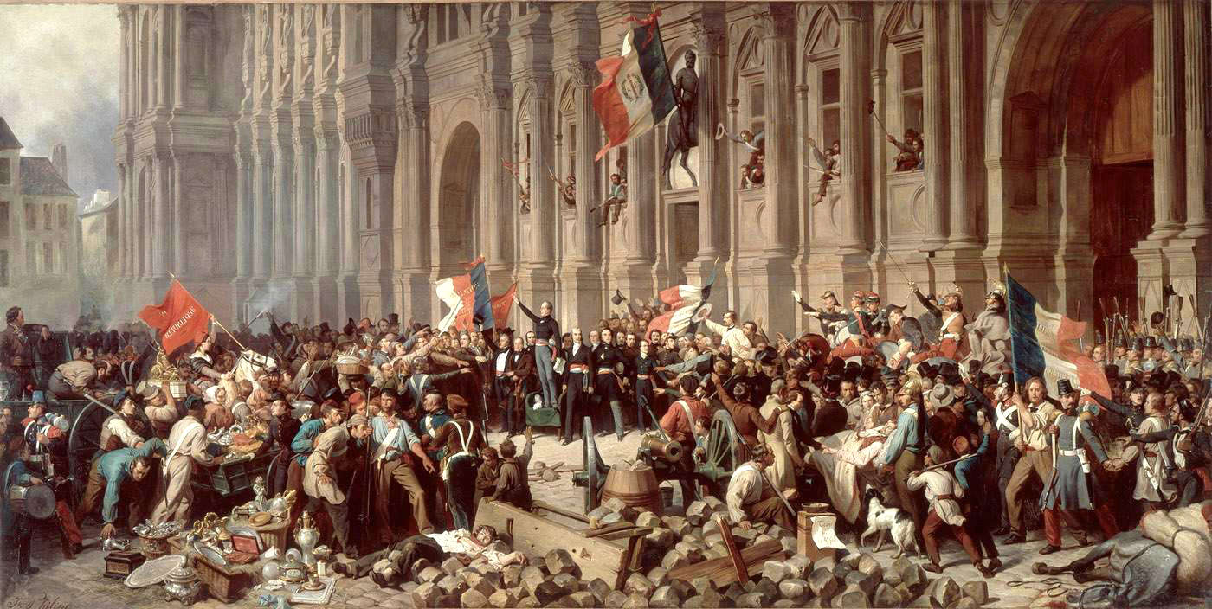
The Opening Phase
Revolution in France leads to other revolutions in Europe ¹
Hungary, Rhineland, Vienna, Berlin, Milan, Venice ¹
All call for constitution, rights, liberty, free press ¹
Pattern:
News about revolution in France spreads, groups discuss in cafés → governments will try to suppress with troops → a particular event happens (a shot from a soldier, a person with a gun) → barricades rise (influenced by Paris) ¹
Success is celebrated, newspapers and pamphlets multiply ¹
< http://www.age-of-the-sage.org/history/1848/philippoteaux_Lamartine_HoteldeVille25Fev1848.jpg >
¹ (Chambers)

Slide 5
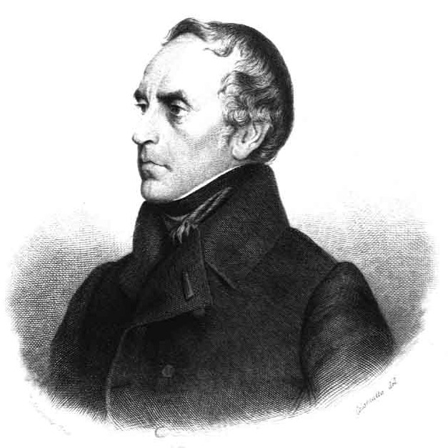
The Opening Phase - France
François Guizot (liberal, talked of grand concepts
of liberty, progress; prime minister of July
Monarchy) ¹
Led the liberal part of the July Monarchy ¹
Government fails to grant larger suffrage → July
Monarchy falls ¹
Government tries to ban a campagne de
banquet (“campaign banquet”- a political meeting)
in Paris scheduled for February 22, 1848 ¹
Some in Chamber of Deputies say they will attend ^{1, 2}
Crowds form barricades ¹
Louis Philippe abdicates, France declared republic – The Second Republic ¹
New cabinet:
Has many moderates, Alphonse de Lamartine (Romantic poet) is leader ¹
Cooperates with more radical ideas ¹
Universal male suffrage ¹
Still displays control – does not interfere with other revolutions, rejects red flag and keeps the tricolor, make new taxes ¹
Good relationship with Church ¹
Constituent assembly is voted for ¹
Guizot
<http://projects.chass.utoronto.ca/langueXIX/images/guizot.jpg>
<http://www.flagsinformation.com/french-flag.png>
¹ (Chambers)
² (“Campagne des Banquets”)

Slide 6
The Opening Phase – Hungary and Austria
Hungary:
Became a fight for independence from the Habsburg Austria ²
Hungarian Diet (like English Parliament) supports Lajos Kossuth (Magyar) who demanded representative government, national autonomy, reform on March 3, 1848 ^{1, 2}
April Laws: free press, national guard, end to feudalism, nobles required to pay taxes, Transylvania ruled by Hungary ^{1, 3, 4, 5}
Non-Magyars (Hungarian) opposed by non-Magyars ^{3,} ⁵
Vienna hires these groups of people to create force and defeat Hungarians ³
Austria:
Vienna allows Hungary to make own taxes and have army ¹
People of Vienna wants republic for Austria as well ¹
Metternich leaves ¹
No censorship, a promised constitution, universal male suffrage ¹
Hungarian’s revolution causes other revolutions in Austrian Empire which seems to be weakening ¹
<http://www.crwflags.com/fotw/images/h/hu-1848.gif>
<http://images.wikia.com/althistory/images/2/2c/Austria_Flag_2_(Nat._1848).png >
¹ (Chambers)
² (“Hungarian Revolution of 1848” - wiki)
³ (“Hungarian Revolution of 1848”)
⁴ (Urban)
⁵ (Plessen)

Slide 7
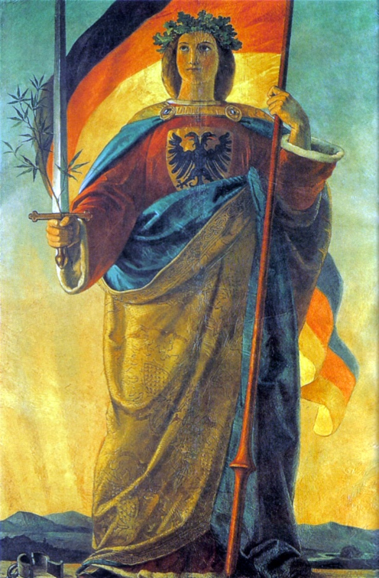
The Opening Phase - Germany
< http://www.crwflags.com/fotw/images/d/de_naval.gif >
Also known as “March Revolution” ³
Part of the pan-Germanism movement – desire to unify all German-speaking countries in Europe ³
Frederick William IV of Prussia hears of revolutions in Vienna → grants delayed concessions, eases censorship, summons Landtag (like English Parliament) ^{1,} ²
Violence occurs, Frederick William IV removes
army in Berlin and speaks of “Germany”, while
wearing the national colors of Germany ¹
Evokes national sentiment, designed to placate people
Constituent assembly voted for through general
male suffrage ⁴
Varied throughout German states; was direct or
indirect ⁴
Voters had to be “independent” ← was vague ⁴
May: Frankfurt Parliament ¹
Goal: write constitution for Germany ¹
Liberals make up most ¹
Generally want monarchy with a liberal constitution ¹
<http://upload.wikimedia.org/wikipedia/commons/c/cd/Image_Germania_%28painting%29.jpg>
¹ (Chambers)
² (“Landtag”)
³ (“Revolutions of 1848 in the German States”)
⁴ (Mattheisen)

Slide 8
The Opening Phase - Italy
Click for Wikipedia article!
<http://worldpics.com.au/Italy/flags/slides/04Italykingdom1861.gif>
Ideas of Giuseppe Mazzini (Italian nationalist) ¹
Defied the agreements made in Congress of Vienna of 1815 ¹
Generally against conservative Austrian powers; Italian states desire freedom from foreign powers
Revolt in Palermo against Naples rule on Jan. 12, Naples king gives constitution (Feb. 10). ¹
Happens before French revolution, but French revolution influenced others to demand constitution ¹
Naples, Tuscany, Piedmont, Papal States (pope and College of Cardinals granted power to veto) granted constitutions ¹
“Five Glorious Days of Milan” – fight against Austria in Milan, Austria retreats ¹
Venice becomes a republic like before ¹
Possibility of returning to independent Italy → nationalism wave → Piedmont joins revolt against Austria ¹
¹ (Chambers)
² (“Revolutions of 1848 in the Italian States”)

Slide 9
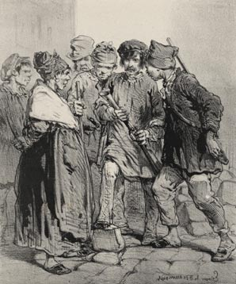
The Fatal Dissensions
Fracturing of opinions and social groups of revolutionaries ¹
Ex: workers vs. middle class in France ¹
Shows power of a military force ¹
More radical ideas, popular anger ¹
Showed that conservatism was starting to push back ¹
<http://www.tocqueville.culture.fr/images/annexes/revolution/anim_013.jpg>
¹ (Chambers)

Slide 10
Fatal Dissensions - France
Disagreements between social classes ¹
workers vs. middle class ¹
National workshops – places where work was provided for the unemployed ²
Application of socialist theories to employment issues ³
New innovation by minister of public works: Marie ³
Instead of old “charity house,” contributes to society ³
National workshops considered waste of money → government abolishes on June 21 ³
Also requires workers under 25 to join army ³
June Days: Workers build barricades in Paris, fought against Republic’s army (lead by General Cavaignac) for three days (June 23-26) ^{1, 4}
Cavaignac is almost dictatorial: limits press, stops radical societies, restrict workers ¹
Still declares self as republican, assembly still writing constitution
Second Republic seems insincere
<http://www.flagsinformation.com/french-flag.png>
¹ (Chambers)
² (“National Workshops”)
³ (Bonin)
⁴ (Castelli)

Slide 11
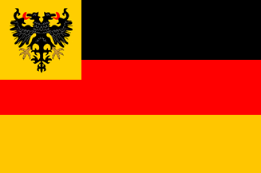
Fatal Dissensions – Germany and Austria
More radical ideas, popular demands ¹
Germany:
Workers vs. middle class ¹
Frankfurt Parliament disregards non-Germans ¹
Supports defeat of other revolutions ¹
Ex: supports Austrian army’s attack of Prague, asks Prussian army to suppress Polish uprising ¹
Frankfurt Parliament calls for Prussian troops to put down uprisings in Frankfurt ¹
Austria
Habsburgs (conservative) becoming stronger ¹
Place Hungarians and Croatians (who want autonomy from Hungary) against each other
Bombards Prague (Pan-Slav (movement to unify
all Slavics) meeting place), destroys worker revolt ^{1, 2,}
Gains peasant support through abolishing feudalism
and peasants’ suspicion of revolutionaries ¹
<http://www.crwflags.com/fotw/images/d/de_naval.gif >
<http://images.wikia.com/althistory/images/2/2c/Austria_Flag_2_(Nat._1848).png>
¹ (Chambers)
² (“The Revolutions of 1848”)
³ (“Pan-Slavism”)

Slide 12
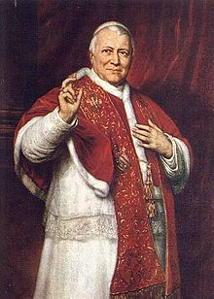
Fatal Dissensions – Italy
<http://worldpics.com.au/Italy/flags/slides/04Italykingdom1861.gif>
Growing radicalism ¹
Pope Pius IX
Made reforms that did little to help economic and political crisis ²
Refuses to support war against Habsburg Austria because Austria is another Catholic country ²
Nov. 25: Flees to Kingdom of Naples when violence erupts in Rome and prime minister is assassinated ¹
Kingdom of Naples becomes named Roman Republic ¹
Pope Pius IX
<http://upload.wikimedia.org/wikipedia/commons/thumb/9/91/Popepiusix.jpg/220px-Popepiusix.jpg>
¹ (Chambers)
² (“Revolutions of 1848 in the Italian States”)

Slide 13
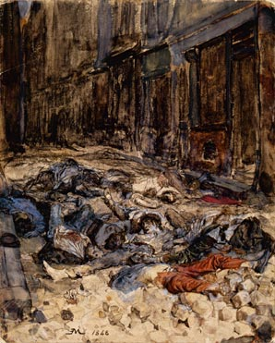
The Final Phase
New revolutions are put down ¹
Military power is again crucial ¹
“The Barricade in Rue Mortellerie” – Meissonier ¹
<http://www.tocqueville.culture.fr/images/annexes/revolution/anim_023.jpg>
¹ (Chambers)

Slide 14
The Final Phase - France
After June Days, France more conservative ³
Dec. 20 – Elected Louis Napoleon as president ¹
Nephew of Emperor Napoleon Bonaparte ¹
Name attracts voters ¹
Declares himself as republican ¹
Discusses social needs, workers’ rights ¹
Catholic Church and monarchists support him, as well as peasants ¹
" In order to recall me from exile, you have elected me a representative of the people; on the eve of choosing a chief magistrate for the republic my name presents itself to you as a symbol of order and security” ²
-Louis Napoleon Bonaparte, November 1848 ²
Plays on nationalism, sentiment for Emperor Napoleon
<http://www.flagsinformation.com/french-flag.png>
¹ (Chambers)
² (“Documents of the Revolution of 1848 in France”)
³ (“French Revolution of 1848”)

Slide 15
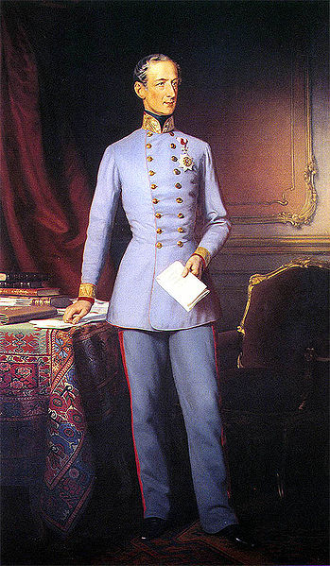
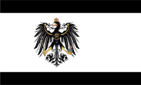
The Final Phase – Austria and Prussia
Austria:
Felix von Schwarzenberg replaces Metternich ¹
Dec: convinces Emperor Ferdinand I of Austria
to abdicate to nephew Franz Joseph I
(18 years old) ^{1, 2}
To gain a new start ¹
Franz Joseph I generally considered reactionary
(desires to return to previous way of things) ^{2, 3}
Crushes revolutionaries in Vienna
Schwarzenberg denies Hungary a constitution
→ Hungary declares as a republic ¹
Months of fighting until Russia enters conflict
and Hungary is put down ¹
Prussia
King Frederick William IV ends Landtag,
decides to form own constitution ¹
Returned to Prussia of February
(before revolutions started) ¹
<http://images.wikia.com/althistory/images/2/2c/Austria_Flag_2_(Nat._1848).png>
<http://images.wikia.com/althistory/images/4/4d/Prussia_(Nat._1848).png>
Felix von Schwarzenberg
<http://upload.wikimedia.org/wikipedia/commons/thumb/7/78/Schwarzenberg%2C_Felix.jpg/349px-Schwarzenberg%2C_Felix.jpg>
¹ (Chambers)
² (Franz Joseph I of Austria”)
³ (“Reactionary”)

Slide 16
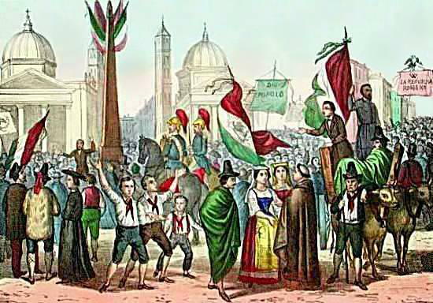
The Final Phase – Germany and Italy
<http://www.crwflags.com/fotw/images/d/de_naval.gif >
Germany:
March 27, 1849: Frankfurt Assembly completes constitution ¹
Elects King Frederick William IV of Prussia to be ruler ¹
Turns down “crown from the gutter” (Chambers 710).
More revolts in German states (Rhineland, Saxony, Baden) ¹
Put down by Prussian forces ¹
Italy:
March 23, 1849: Piedmont put
down by Austria forces ¹
Italy left in severe debt, with a disliked
government, shaky constitution ¹
Roman Republic
Tried to make constitution, improve
social and economic conditions ²
French armies intervene, tries to
restore pope and defeat Roman Republic ¹
June 30, 1849: French defeats Rome ¹
August 28, 1849: last republic (Venice) falls ¹
<http://worldpics.com.au/Italy/flags/slides/04Italykingdom1861.gif>
Declaration of Roman Republic
<http://www.age-of-the-sage.org/history/1848/Rossetti_Roman_Republic.jpg>
¹ (Chambers)
² (Noether)

Slide 17
Conclusions
“The turning-point at which modern history failed to turn” – G. M. Trevelyan (Chambers 712).
Five general aspects ¹
Liberal constitutions and greater rights did not gain secure support from peasants, artisans, workers ¹
Revolutions generally led by middle class ¹
Have negative reaction towards radicals, fear for private property and order
Cannot keep power because of class distinction ¹
Fracturing of revolutionaries by nationalism ¹
Revolutionary leaders new to “practical politics” (Chambers 712)
Leave previous authorities with means to revolt ¹
None of the major powers fully supported revolution ¹
Effects
Showed failure for change, influence of political ideas, demands of new generation of social changes ¹
Some success is won: ¹
Abolishing of serfdom in Prussia and Austrian empire ¹
New constitutions in Piedmont and Prussia ¹
Showed importance of popular support and nationalism ¹
¹ (Chambers)

Slide 18
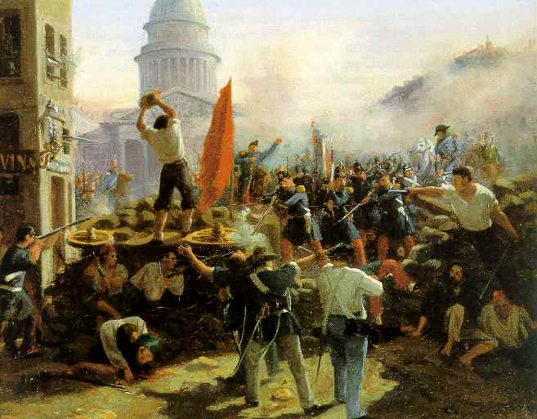
Common Aspects
Barricades
Influenced from Paris ¹
Constructed out of stones,
furniture, general debris ¹
Involved cooperation
of all people ¹
“the people’s voice”
(Chambers 707).
Barricade in Paris
<http://owni.eu/files/2011/03/1848.jpg>
¹ (Chambers)

Slide 19
Works Cited
"Campagne Des Banquets." Wikipedia. Wikimedia Foundation, 24 Sept. 2012. Web. 27 Jan. 2013. <http://en.wikipedia.org/wiki/Campagne_des_banquets>.
"Documents of the Revolution of 1848 in France." Hanover Historical Texts Project. Ed. J. H. Robinson. Hanover College, Mar. 2001. Web. 28 Jan. 2013. <http://history.hanover.edu/texts/fr1848.html>.
"Franz Joseph I of Austria." Wikipedia. Wikimedia Foundation, 27 Jan. 2013. Web. 27 Jan. 2013. <http://en.wikipedia.org/wiki/Franz_Joseph_I_of_Austria>.
"Hungarian Revolution of 1848." Wars of the World. Armed Conflict Events Data, 16 Dec. 2000. Web. 27 Jan. 2013. <http://www.onwar.com/aced/nation/hat/hungary/fhungary1848.htm>.
"Landtag." Wikipedia. Wikimedia Foundation, 30 Dec. 2012. Web. 27 Jan. 2013. <http://en.wikipedia.org/wiki/Landtag>.
"Liberalism." The Columbia Encyclopedia. New York: Columbia University Press, 2008. Credo Reference. Web. 26 January 2013. < http://www.credoreference.com/topic/liberalism>.
"Liberalism." Wikipedia. Wikimedia Foundation, 26 Jan. 2013. Web. 26 Jan. 2013. <http://en.wikipedia.org/wiki/Liberalism>.
"National Workshops." Wikipedia. Wikimedia Foundation, 01 Oct. 2012. Web. 27 Jan. 2013. <http://en.wikipedia.org/wiki/National_Workshops>.
"Pan-Slavism." Wikipedia. Wikimedia Foundation, 27 Jan. 2013. Web. 27 Jan. 2013. <http://en.wikipedia.org/wiki/Pan-Slavism>.
"Reactionary." Wikipedia. Wikimedia Foundation, 24 Jan. 2013. Web. 27 Jan. 2013. <http://en.wikipedia.org/wiki/Reactionary>.
"Revolutions of 1848 in the German States." Wikipedia. Wikimedia Foundation, 27 Jan. 2013. Web. 27 Jan. 2013. <http://en.wikipedia.org/wiki/Revolutions_of_1848_in_the_German_states>.
"Revolutions of 1848 in the Habsburg Areas." Wikipedia. Wikimedia Foundation, 27 Jan. 2013. Web. 27 Jan. 2013. <http://en.wikipedia.org/wiki/Revolutions_of_1848_in_the_Habsburg_areas>.
"Revolutions of 1848 in the Italian States." Wikipedia. Wikimedia Foundation, 24 Jan. 2013. Web. 27 Jan. 2013. <http://en.wikipedia.org/wiki/Revolutions_of_1848_in_the_Italian_states>.
"The French Revolution of 1848." Age-of-the-sage. N.p., n.d. Web. 27 Jan. 2013. <http://www.age-of-the-sage.org/history/1848/french_revolution_1848.html>.
"The French Revolution of 1848." Age-of-the-sage. N.p., n.d. Web. 27 Jan. 2013. <http://www.age-of-the-sage.org/history/1848/french_revolution_1848.html>.
"The Revolutions of 1848." The History Page. Ed. Larry E. Gates, Jr. Larry E. Gates, Jr., n.d. Web. 27 Jan. 2013. <http://www.historydoctor.net/Advanced%20Placement%20European%20History/Notes/revolutions_of_1848.htm>.
Bonin, Hubert. "Employment and the Revolution of 1848 in France." Encyclopedia of 1848 Revolutions. James Chastain, 20 Oct. 2004. Web. 27 Jan. 2013. <http://www.ohio.edu/chastain/dh/francemp.htm>.
Castelli, Helen. "June Days." Encyclopedia of 1848 Revolutions. James Chastain, 20 Oct. 2004. Web. 27 Jan. 2013. <http://www.ohio.edu/chastain/ip/junedays.htm>.
Chambers, Mortimer. The Western Experience. 9th ed. New York: McGraw-Hill Companies, 2007. Print.
Mattheisen, Donald. "Frankfurt Parliament Election." Encyclopedia of 1848 Revolutions. James Chastain, 14 Oct. 2004. Web. 27 Jan. 2013. <http://www.ohio.edu/chastain/dh/frktele.htm>.
Noether, Emiliana P. "Roman Republic." Encyclopedia of 1848 Revolutions. James Chastain, 25 Oct. 2004. Web. 27 Jan. 2013. <http://www.ohio.edu/chastain/rz/romanrep.htm>.
Plessen, Marie-Louis Von, and Martin Roth. "The Revolution of 1848 - The European Dimension." Deutsches Historisches Museum. DHM, n.d. Web. 27 Jan. 2013. <http://www.dhm.de/ENGLISH/ausstellungen/bismarck/77.htm>.
Urban, Aladar. "April Laws, Hungarian." Encyclopedia of 1848 Revolutions. James Chastain, 14 Oct. 2004. Web. 27 Jan. 2013. <http://www.ohio.edu/chastain/ac/aprilaw.htm>.

Slide 20
Pictures
http://images.wikia.com/althistory/images/2/2c/Austria_Flag_2_(Nat._1848).png
http://images.wikia.com/althistory/images/4/4d/Prussia_(Nat._1848).png
http://owni.eu/files/2011/03/1848.jpg
http://platypus1917.org/wp-content/uploads/2010/05/Jerzy-maerz1848_berlin.jpg
http://projects.chass.utoronto.ca/langueXIX/images/guizot.jpg
http://upload.wikimedia.org/wikipedia/commons/c/cd/Image_Germania_%28painting%29.jpg
http://upload.wikimedia.org/wikipedia/commons/thumb/7/78/Schwarzenberg%2C_Felix.jpg/349px-Schwarzenberg%2C_Felix.jpg
http://upload.wikimedia.org/wikipedia/commons/thumb/9/91/Popepiusix.jpg/220px-Popepiusix.jpg
http://worldpics.com.au/Italy/flags/slides/04Italykingdom1861.gif
http://www.age-of-the-sage.org/history/1848/philippoteaux_Lamartine_HoteldeVille25Fev1848.jpg
http://www.age-of-the-sage.org/history/1848/Rossetti_Roman_Republic.jpg
http://www.crwflags.com/fotw/images/d/de_naval.gif
http://www.crwflags.com/fotw/images/h/hu-1848.gif
http://www.flagsinformation.com/french-flag.png
http://www.globalresearch.ca/articlePictures/French%20Revolution.jpg
http://www.tocqueville.culture.fr/images/annexes/revolution/anim_013.jpg
http://www.tocqueville.culture.fr/images/annexes/revolution/anim_023.jpg

